Slide 1
HW3
B10907034 王信舜

Slide 2
Problem 1 (RF_pulse_time = 0)
def Mz_Mxy(t, alpha, TR, T1, T2_star):
Mz = np.empty(t.shape)
Mxy = np.empty(t.shape)
temp = 0
M0 = 1
for idx, tt in enumerate(t):
if tt == 0:
Mz[idx] = temp = np.cos(alpha * np.pi / 180)
M0 = Mxy[idx] = np.sin(alpha * np.pi / 180)
elif tt % TR == 0:
Mz[idx] = temp = Mz[idx-1] * np.cos(alpha * np.pi / 180)
M0 = Mxy[idx] = Mz[idx-1] * np.sin(alpha * np.pi / 180)
else:
Mz[idx] = (1 - temp) * (1 - np.exp(-(tt % TR)/T1)) + temp
Mxy[idx] = M0 * np.exp(-(tt % TR)/T2_star)
return Mz, Mxy

Slide 3
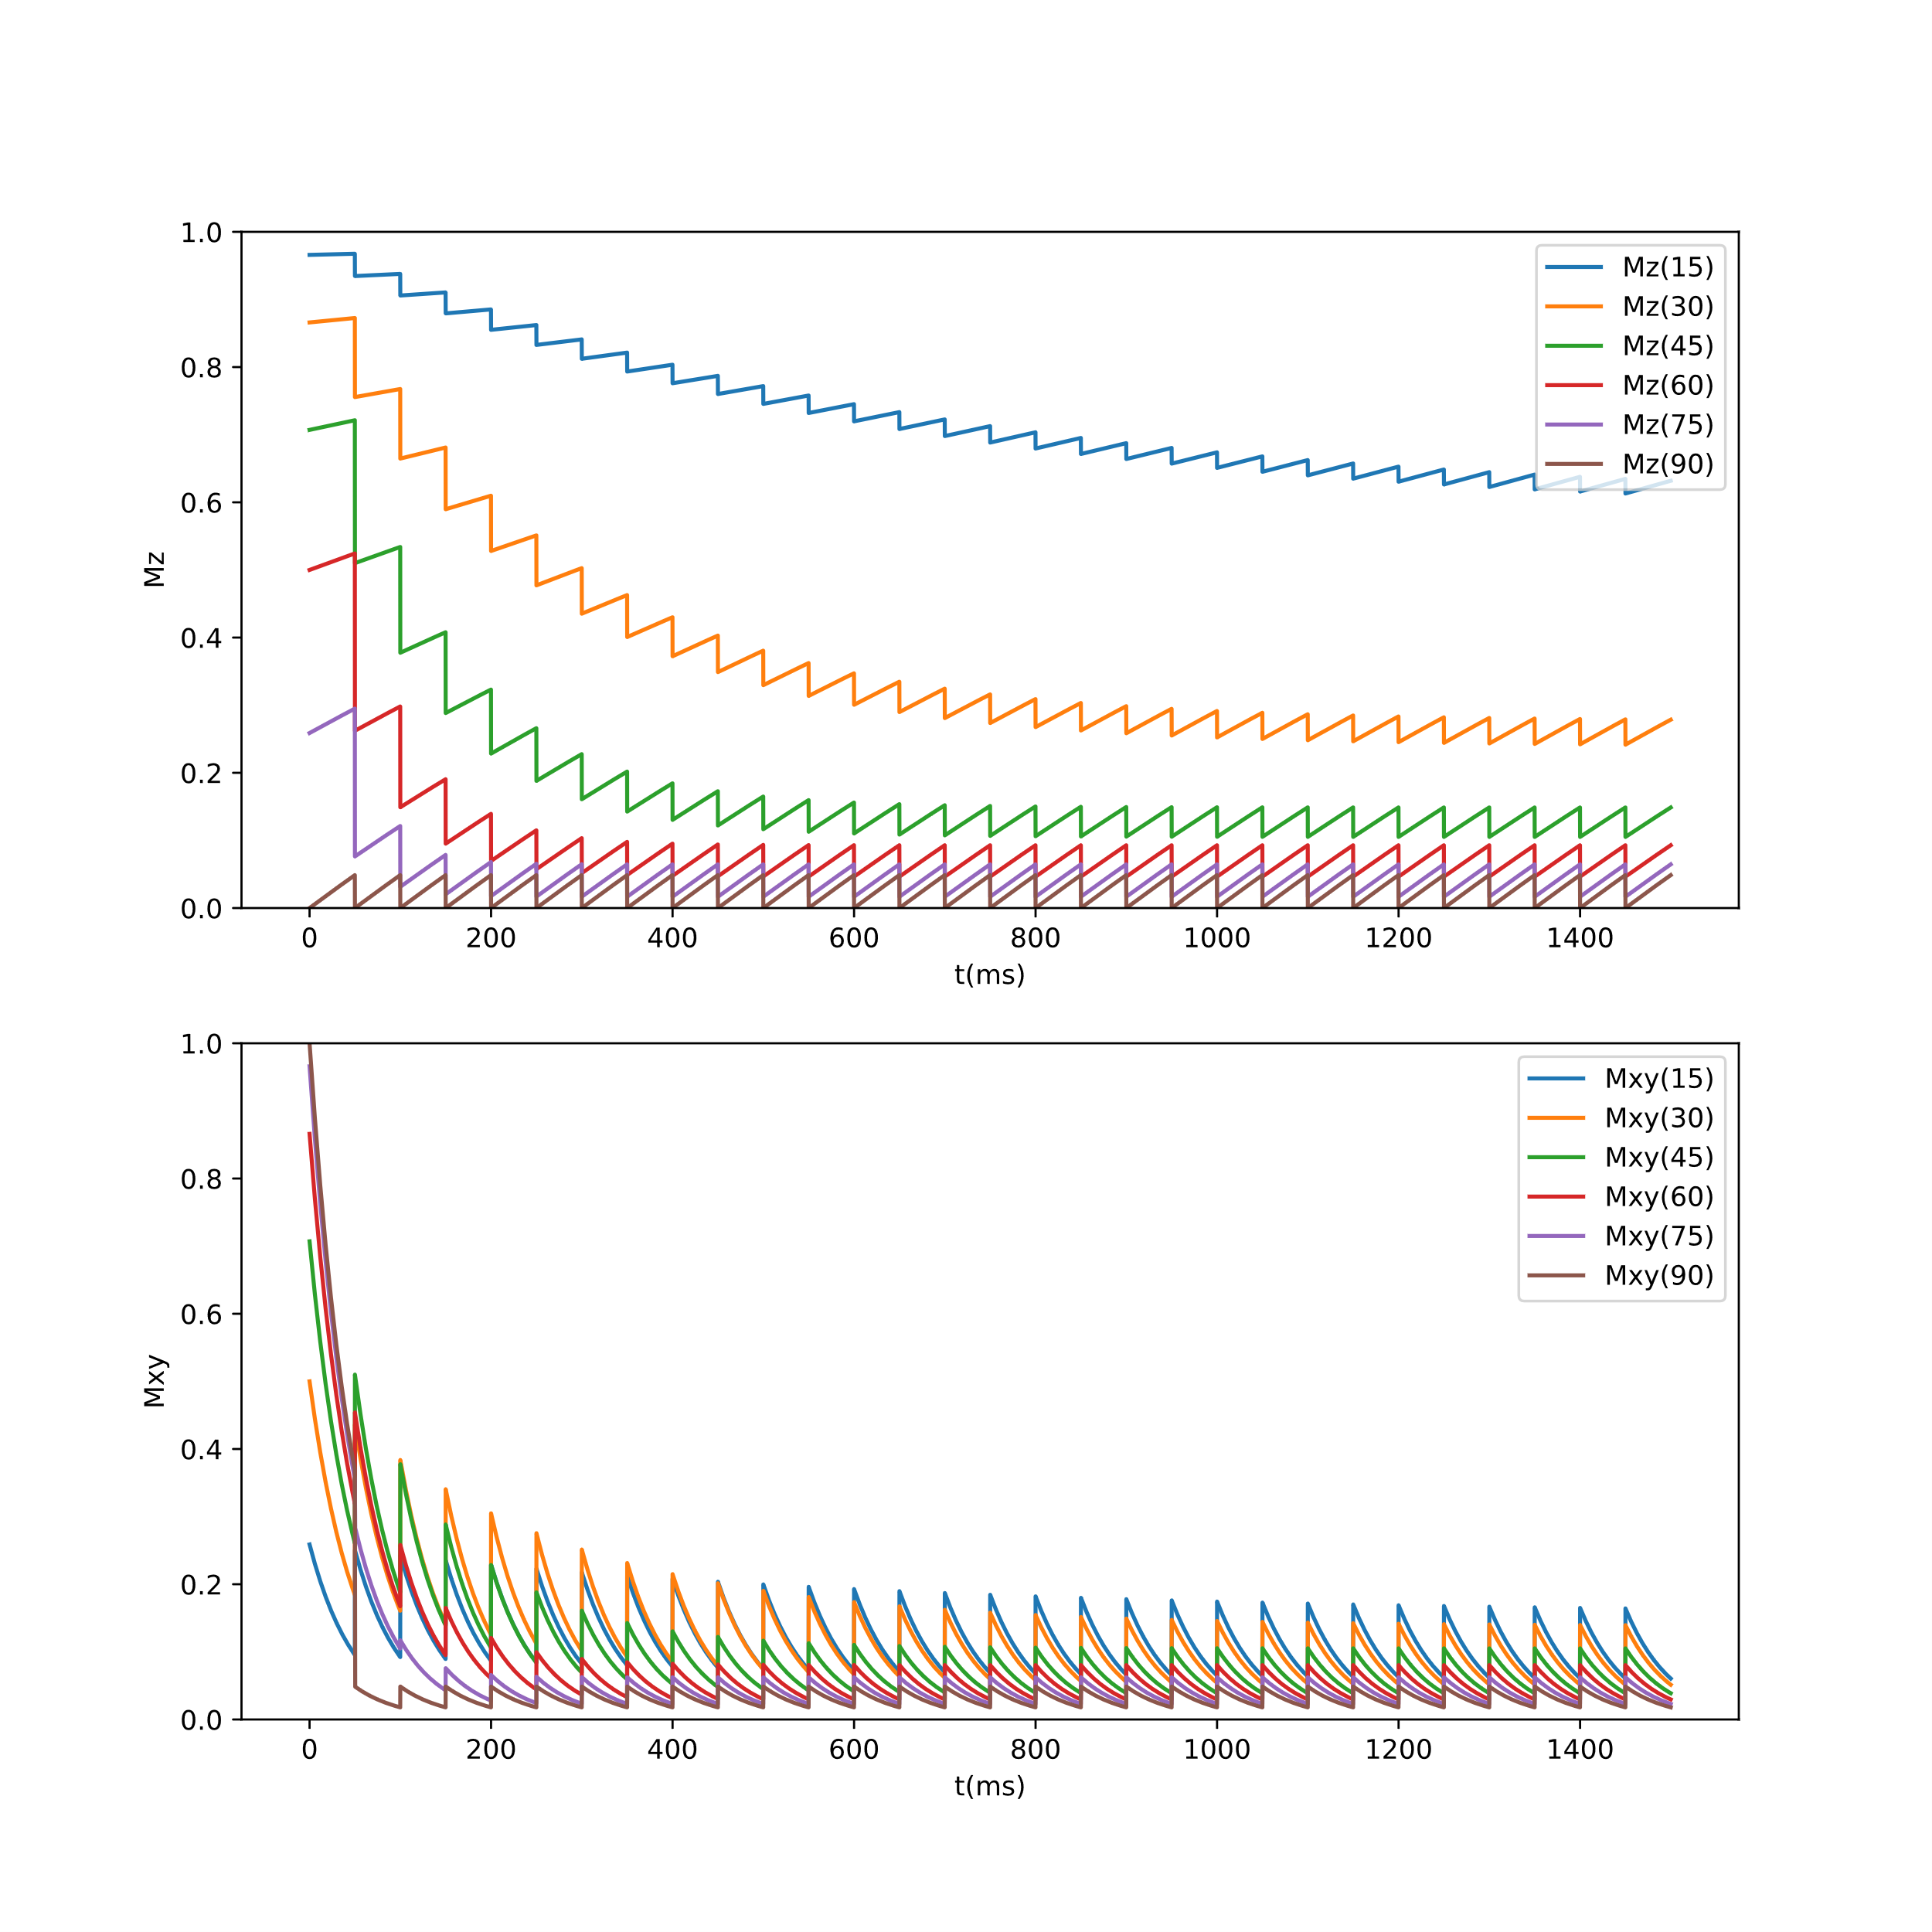

Slide 4
Problem 1 (RF_pulse_time = 15ms)
def flip(t, t_pulse, TR):
x = np.empty(t.shape)
for idx, tt in enumerate(t):
if tt % TR < t_pulse:
x[idx] = np.sin(2 * np.pi * (1/(2*t_pulse)) * (tt % TR))
else:
x[idx] = 0
return x

Slide 5
def Mz_Mxy(t, t_pulse, alpha, TR, T1, T2_star):
Mz = np.empty(t.shape)
Mxy = np.empty(t.shape)
temp = 1
M0 = 0
for idx, tt in enumerate(t):
if tt == 0:
Mz[idx] = temp
Mxy[idx] = M0
elif tt % TR == 0:
Mz[idx] = temp = Mz[idx-1]
Mxy[idx] = Mxy[idx-1]
elif tt % TR < (t_pulse * alpha / 180):
Mz[idx] = temp * np.cos(2 * np.pi * (1/(t_pulse*2)) * (tt % TR))
M0 = Mxy[idx] = temp * np.sin(2 * np.pi * (1/(t_pulse*2)) * (tt % TR))
else:
tmp = temp * np.cos(alpha * np.pi / 180)
Mz[idx] = (1 - tmp) * (1 - np.exp(-(tt % TR - (t_pulse * alpha / 180) )/T1)) + tmp
Mxy[idx] = M0 * np.exp(-(tt % TR - (t_pulse * alpha / 180) )/T2_star)
return Mz, Mxy

Slide 6
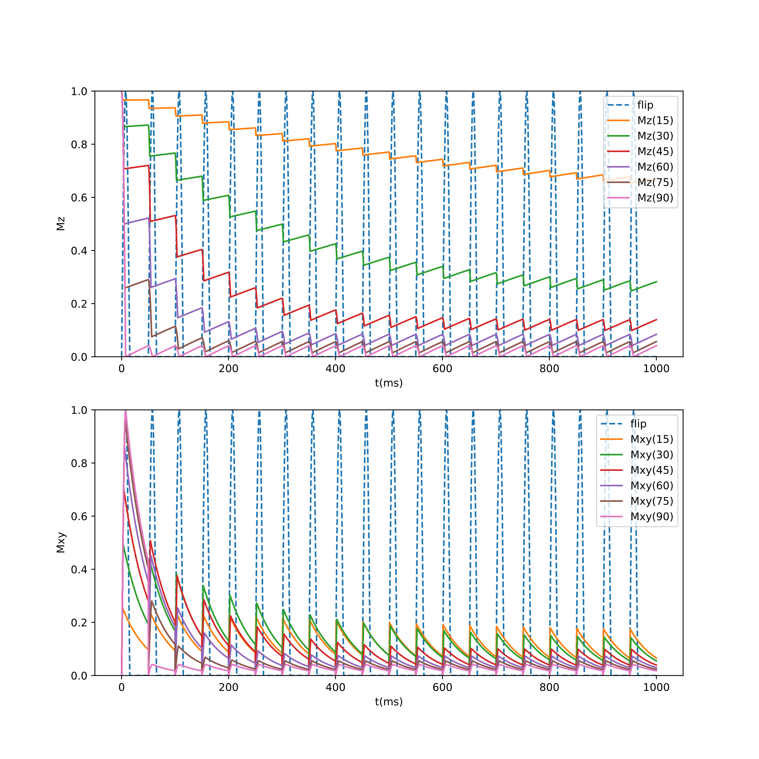

Slide 7
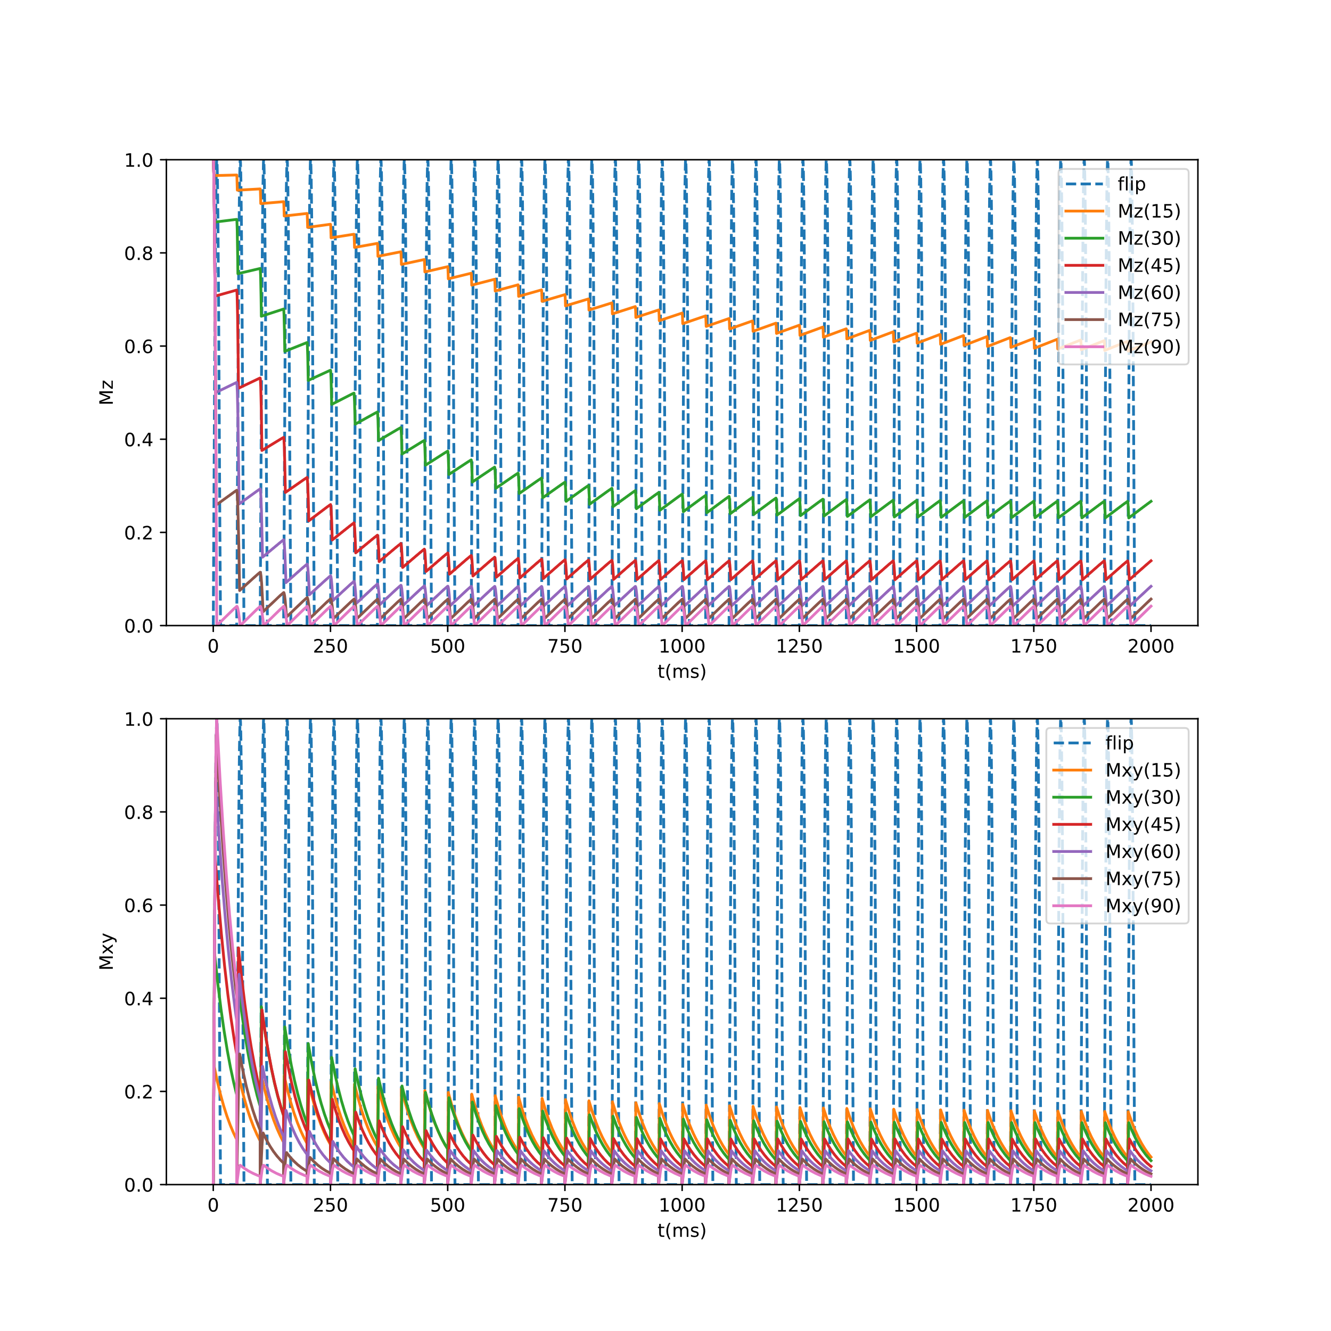

Slide 8
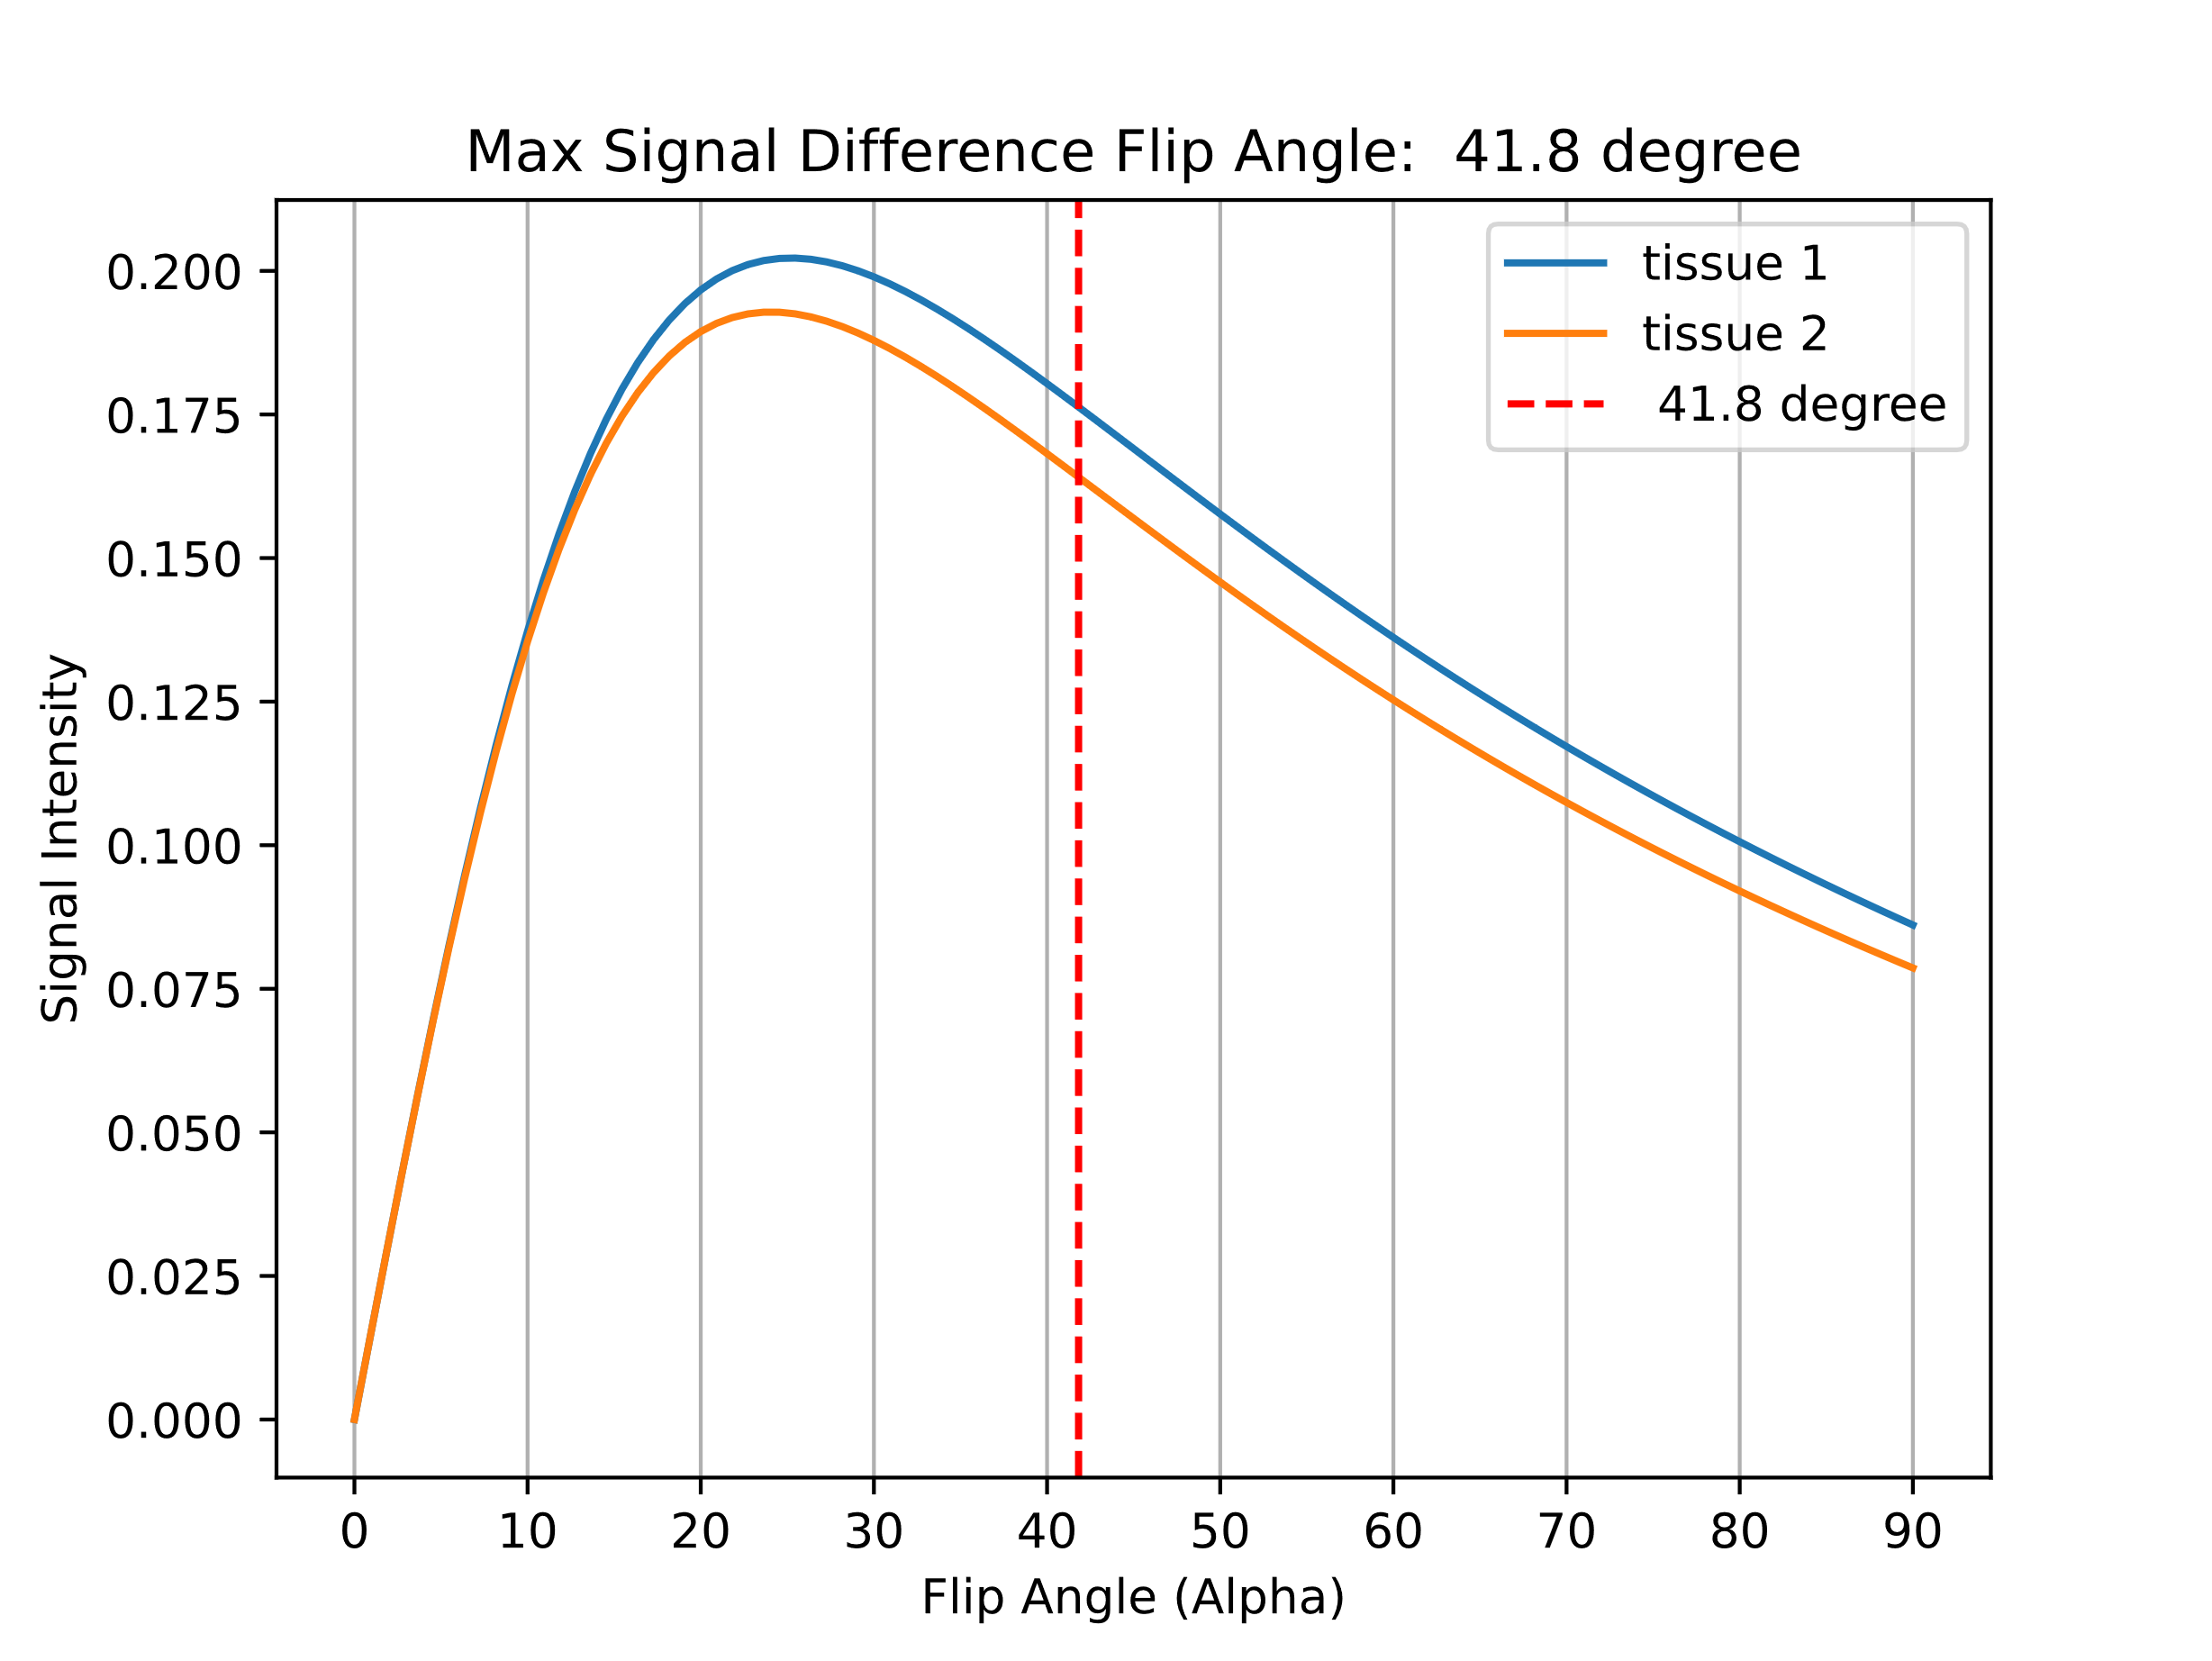
Problem 2
TE = 5ms

Slide 9
Problem 3
Pearson product-moment correlation coefficient (between volumes of the subcortical structures and age of the subjects)
Left Thalamus | -0.549 | Right Thalamus | -0.491
Left Caudate | -0.325 | Right Caudate | -0.200
Left Putamen | -0.381 | Right Putamen | -0.430
Left Pallidum | -0.329 | Right Pallidum | -0.377
Left Hippocampus | -0.280 | Right Hippocampus | -0.242
Left Amygdala | -0.305 | Left Amygdala | -0.286

Slide 10
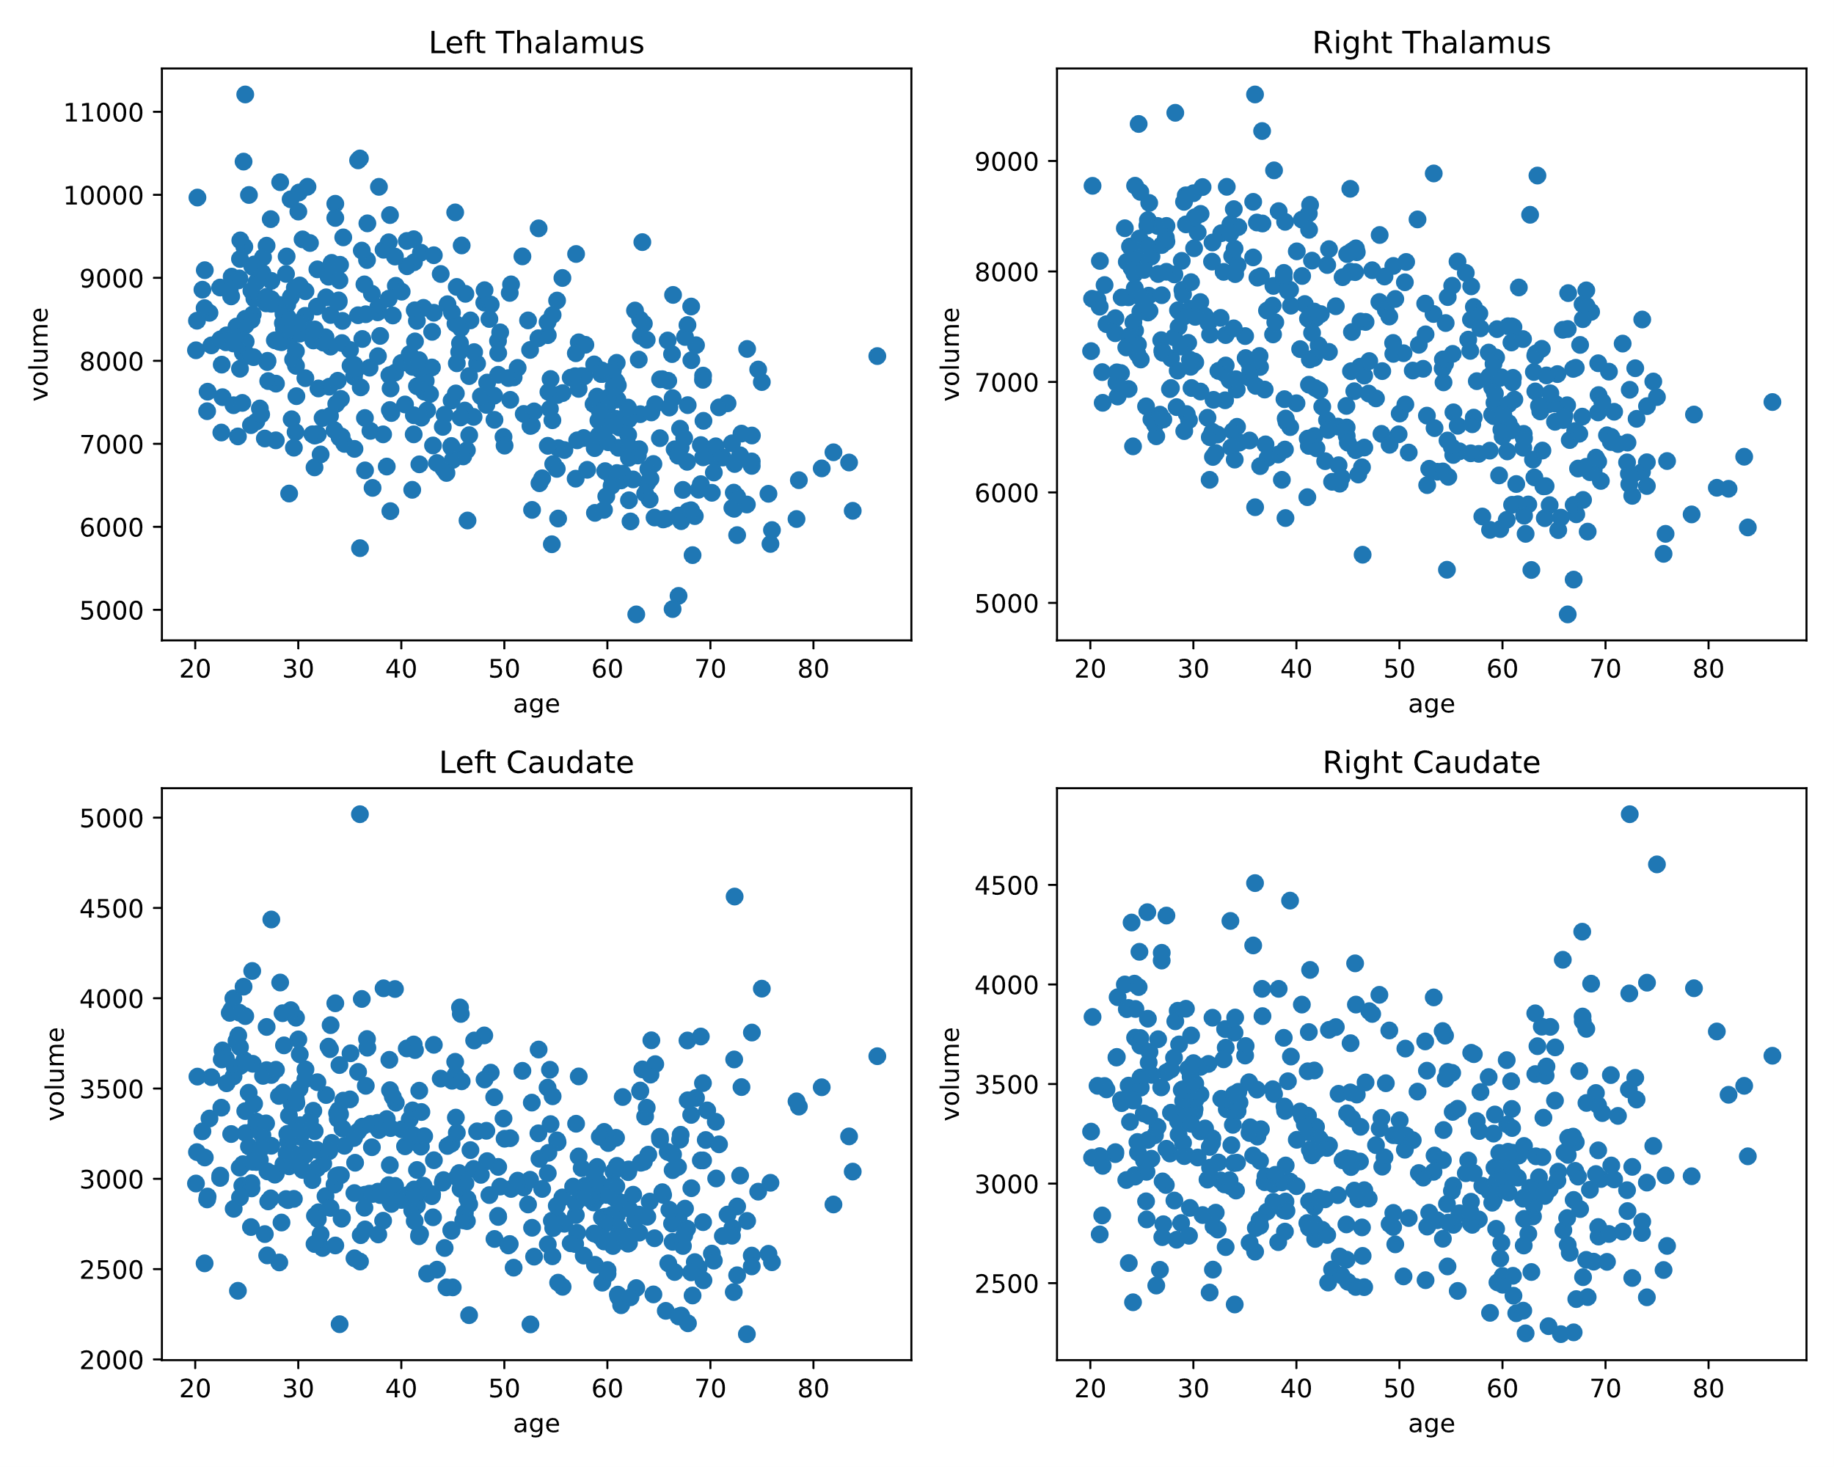

Slide 11
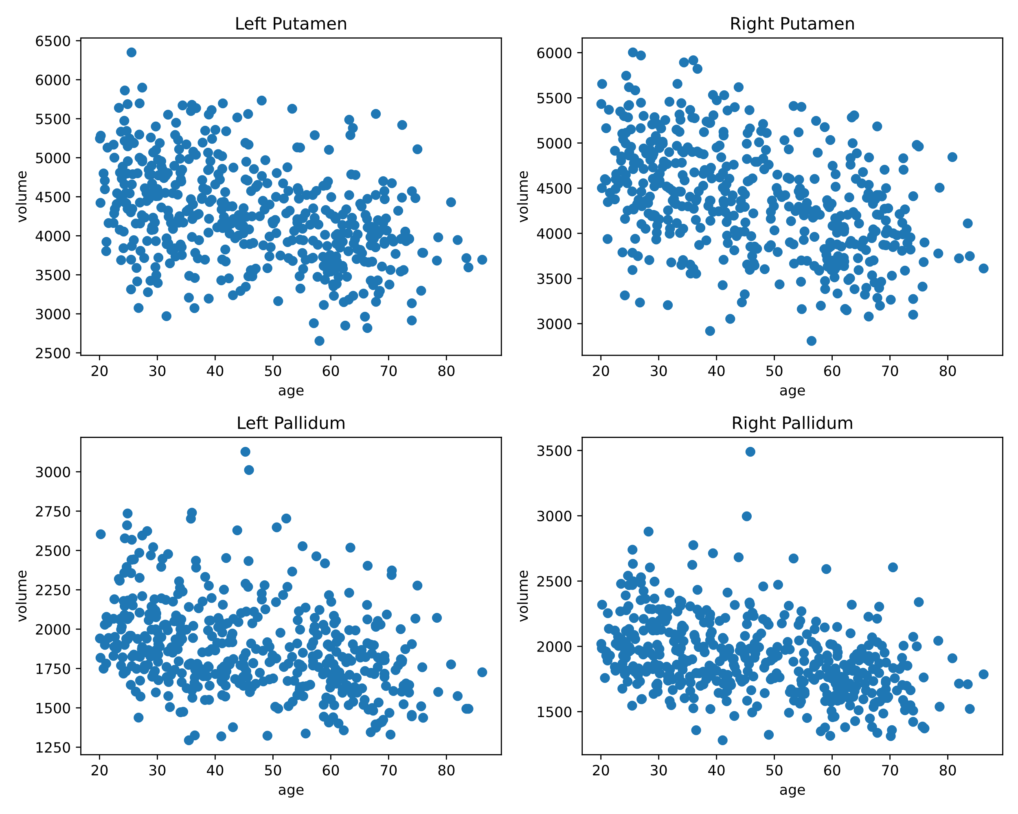

Slide 12
